Slide 1
Web Security Part II

Slide 2
Recap Week 11
HTTP is stateless
Web applications establish sessions to maintain state
  Session IDs are subject to hijacking attacks
Same origin policy: isolate scripts and resources based on their origin
Cross-Site Scripting: a kind of code injection attack
  Can steal Session IDs or other information from client side
  Three types: Stored XSS, Reflected XSS & Dom-based XSS
  Defence strategies: filtering/sanitization, improved access control
Notes:
Stateless : they wont know anything about each other in each request and response. Only aware about each other. State maintainance
Pay attention to SessID generation, storage and sending. Use SSL/TLS to not show the thing.
If say I want a lot of people to get, it is stored XSS, but if say they got filtering, I can use DOM –based.
Signing/MAC is not good cos it might be very header.
Content Security Policy – a field of some sort.

Slide 3
Overview
Content
  Cross Site Request Forgery (CSRF)
  SQL injection (SQLi)
After this module, you should be able to
    Describe CSRF attacks and how to prevent these attacks
    Describe SQL injection attacks and how to prevent them

Slide 4
Cross Site Request Forgery (CSRF)

Slide 5
Cross-site Request Forgery (CSRF)
Parties involved: attacker, user, server
Cross-site request forgery (XSRF, CSRF) exploits ‘trust’ a target server has in a user to execute actions at the server with the user’s privileges
  Trust: user is in some way authenticated at the server (cookie, authenticated SSL session, ...)
Violates server’s assumption about the end point of a request
Notes:
Attacker exploits the trust placed on the user by the server
Attacker try to trigger the user to send the request.
Trigger attacker to click a link to send a request. I don’t need to know your sessionID, you sent from yourself, and you can just get the result. Server accepts YOU.
Not trying to predict, but trying to trigger the server.
Server believes that the request I sent by the legit user, but the TRIGGER is the attacker.

Slide 6
CSRF – Attack Pattern
User visits a page at attacker’s site and clicks a link;
Or user clicks on a link in email, social media, etc.
When the user clicks the link (crafted by the attacker), the user’s browser will send a request to the target server (pointed by the link)
Server authenticates request as coming from user, because it comes from the user’s browser
  Actions (name and value pairs) in the request are executed by server with access rights of the authenticated user
  Session hijacking attack
Notes:
In both patterns, server thinks that the request comes from the user
You trick the victim.
This is a form of session hijacking.
By default, your browser attaches things like headers and session information into the request.

Slide 7
CSRF Example
A typical GET request for a $100 bank transfer:
GET http://bank.com/transfer.php?acct=User&amount=$100
An attack crafts a malicious URL:
http://bank.com/transfer.php?acct=Attacker&amount=$100
He can embed the URL in his website or distribute the link via social media
Those who click the link while logged into their bank account will unintentionally transfer $100 to attacker

Slide 8
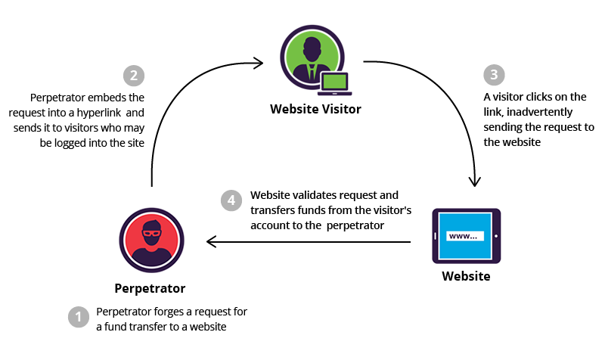
CSRF Example

Slide 9
CSRF Defenses
Ultimate cause of attack: server only authenticates ‘the last hop’ of the entire request, but not the true origin of all its parts
Defense
  Authenticate requests (actions) at the level of the web application (‘above’ the browser)
  Avoid GET requests whenever possible
Notes:
Authenticate the request.
Make your own web app authenticate the request. Not the browser.
Not avoid GET as much as possible, but do not use GET unnecessarily.

Slide 10
CSRF Prevention Tokens
Server creates a random “challenge” token associated with a user session/request
  Per-request tokens are more secure than per-session tokens
Tokens inserted into HTML forms
<form action=“/transfer.do” method=“post”>
<input type="hidden" name=“CSRFToken”
value=“OWY...E1ZMGYwMGEwOA==”>
...
</form>
Notes:
The link has a token. If attacker try to send, then cannot. Server gives the html with a token. This token is unknown to the person.
Put the cookie as part of the request. Encrypt and then put in there.
Requires attacker to know the cookie.
But user should only know it. You can use the header as like a compulsory param.
Server generates a random token and ties it to the user session (or returns in a secure cookie).
The token is included in forms or as a header in AJAX requests.
Server verifies the token on every state-changing request (POST/PUT/DELETE).
Assume cannot read the hidden input field.

Slide 11
CSRF Prevention Tokens
Token value must be fresh
Tokens must be unique and unpredictable
Web application must validate each request by comparing received token to stored one
Requests without token or with wrong token are discarded
Notes:
Tokens must be fresh.

Slide 12
CSRF Protection from User’s Perspective
Log off web applications when not in use
Avoid simultaneously browsing while logged into a sensitive application (e.g. banking application)
You do not want them to “remember me”
Notes:
Logoff so no one will know who you are.

Slide 13
SQL Injection

Slide 14
What is SQL?
Most websites use a database to store data
  such as usernames, passwords, etc.
Web application reads, updates and inserts data in the database
Interaction with the database done via SQL (Structured Query Language)

Slide 15
SQL
SQL: Standard language for accessing relational databases
Fetch a set of records
SELECT * FROM user WHERE ID=‘12’
Add data to the table
INSERT INTO user (name,id) VALUES (‘Jack’,10)
Modify data
UPDATE user SET name=‘Mike’ WHERE id=‘12’
Query syntax (mostly) independent of vendor
No need to write code in the exam
Notes:
Example during login, you can do a attack where you can use someone’s elses redential then baam!

Slide 16
What is SQL Injection?
Gain access to the database by manipulating user inputs used in SQL queries
  Inject special characters (syntactic meaning to SQL parser/interpreter) such as ‘ # OR ; =
  At places such as login forms and URLs:
http://target.com/login.php?user=maliciousinput&psw=maliciousinputs
Can obtain sensitive information such as admin passwords for further exploitation of the system
Can be used to delete database tables, upload files, create reverse shell, etc.

Slide 17
Flow of SQL Injection Attack
Browser
1. Send malicious input
Web Server
4. receive sensitive data
2. Unintended query
3. return query result
Database Server

Slide 18

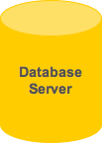
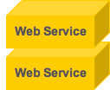
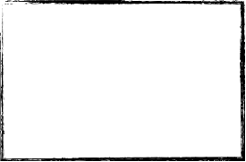
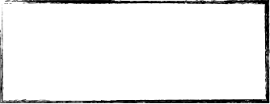
Example: SQL Injection
Name | Surname | …
John | Smith | …
User gets authenticated
Username
John
SELECT * FROM Users
WHERE
usr = ‘John’ AND
psw = ‘1234’
Password
1234
Name | Surname | …
John | Smith | …
OK
Web form
SQL query
Result
Notes:
If server store hash, you need to provide hash.

Slide 19
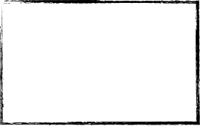
Example: SQL Injection
Username
SELECT * FROM Users
WHERE
usr = ‘’ AND psw = ‘’
OR ‘1’=‘1’
Name | Surname | …
Aalto | Aron | …
John | Smith | …
… | … | …
Password
’ OR ‘1’ = ‘1
Log In
Web form
SQL query
Query result
Notes:
Reconstruct SQL query on your end.

Slide 20
Example: SQL Injection
Username
str1
SELECT * FROM Users
WHERE
usr = ‘’ AND psw = ‘’
OR ‘1’=‘1’; DROP TABLE Users; --
Name | Surname | …
’ OR ‘1’=‘1’; DROP TABLE Users; --
Password
Log in
Eliminate all user accounts

Slide 21
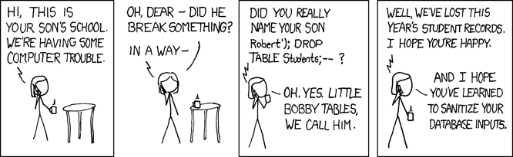
Example: SQL Injection
http://xkcd.com

Slide 22
Remark on SQL Injection
Single quote ’ is the string delimiter in SQL
  E.g. name=‘Jack’ AND age=11
In a web application, a server-side script (e.g. written in PHP) may construct SQL query as a string from user input
String passed to DBMS and executed as SQL query
User input can now be interpreted as code by DBMS!
Broken abstraction:
  No clear distinction between data and code

Slide 23
Defence against SQL Injection
Two fundamental defences:
Sanitize or validate user inputs so that dangerous inputs are made innocuous
  Filtering (blacklist: [’, “, \, …], whitelist: [‘Mary’, ’Jane’, ‘Jack’, …])
  Escaping - Replace dangerous characters with encodings – e.g. ‘ -> \’
Bound parameters so that user inputs cannot be mistaken for code (clean solution to the problem)
Additional precautions:
  Avoid verbose error messages; error messages for invalid inputs can leak information about database, relations, names of columns, etc.
  Least privilege: do not connect as sysadmin
(\ -> tells the SQL interpreter not to interpret the subsequent character with any special meaning)
Notes:
White list is more secure.
Boundparam is like your $stmt->bind_param() so that user input canot be mistaken for code.
Bind params, filtering, and whitelist chars.
Don’t have too much error msg in console and do not connect as sysadmin (set DB perms)?

Slide 24
Example: Bound parameters with prepared statements
Pre-compile query with placeholders; execute query with actual user input:
$uname = $_GET['username'];
$pwd = $_GET['password'];
// :xxxx serves as placeholders in prepared statement
$sql = "SELECT username FROM users WHERE username = :uname AND
password = :pwd";
// Replace :xxxx in the statement with actual input
$stmt = $pdo->prepare($sql);
$stmt->setFetchMode(PDO::FETCH_ASSOC);
$stmt->bind_param(':uname', $uname, PDO::PARAM_STR);
$stmt->bindParam(':pwd', $pwd, PDO::PARAM_INT);
// Run the query
$stmt->execute();
placeholders
No need to write code in the exam

Slide 25
Take Away
Cross Site Request Forgery is a session hijacking attack. It confuses the server because the request comes from the user who is authenticated to a session.
SQL queries are used by web to interact with databases
SQL injection: Attack on the database through the application
  User inputs are used by application in constructing the queries
  Attack exploits this to gain unauthorized access to data stored in database
Notes:
Confuse the server cos the request come from user.

Slide 26
Notes
Subject is triggered by the principal.
Recall and Precision lower is better???
How many bytes you need to overflow a buffer, what is the consequence of you overflowing a buffer.

